Slide 1



Slide 2
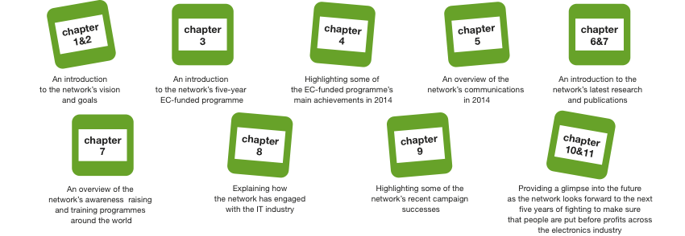
About this presentation
This presentation offers both an introduction to the work of the GoodElectronics Network,
an overview of achievements in 2014, some first results of 2015, and a glimpse further into the future.

Slide 3
What is the GoodElectronics Network?
CHAPTER 1
Launched in 2006, the GoodElectronics Network brings together networks, organisations and individuals that are concerned about human rights, including labour rights, and sustainability issues in
the global electronics supply chain.
The GoodElectronics Network currently
has about 90 member organisations and individuals from 24 countries around the world, including trade unions, labour rights organisations, human rights organisations, environmental organisations, universities, academics and researchers.
The network’s mission is to contribute to improving corporate and public policies and practices with regard to protecting and respecting human rights and the environment along the global electronics supply chain, with a specific focus on big brand companies.
Visit the GoodElectronics Network website here to find out more and to see a full list
of current members.

Slide 4
What would a good electronics industry look like?
CHAPTER 2
GoodElectronics has a vision of a global electronics industry that follows the highest possible international human rights and sustainability standards. Following this vision, labour rights and environmental norms would be protected and respected throughout the entire electronics value chain:

Slide 5
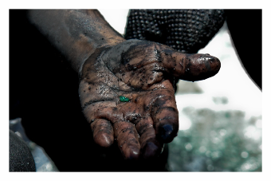
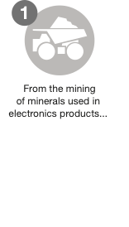
What would a good electronics industry look like?
CHAPTER 2
What would a good electronics industry look like?
GoodElectronics has a vision of a global electronics industry that follows the highest possible international human rights and sustainability standards. Following this vision, labour rights and environmental norms would be protected and respected throughout the entire electronics value chain:
© Getty Images

Slide 6
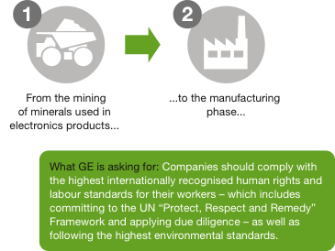
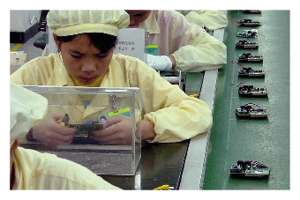
What would a good electronics industry look like?
CHAPTER 2
What would a good electronics industry look like?
GoodElectronics has a vision of a global electronics industry that follows the highest possible international human rights and sustainability standards. Following this vision, labour rights and environmental norms would be protected and respected throughout the entire electronics value chain:
© Creative Commons SOMO / SACOM

Slide 7
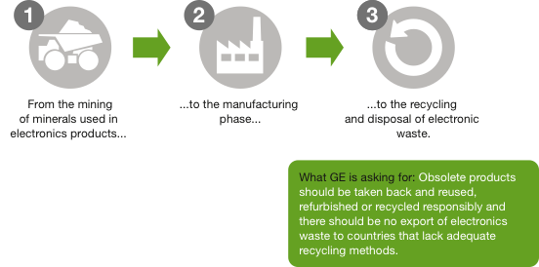
What would a good electronics industry look like?
CHAPTER 2
What would a good electronics industry look like?
GoodElectronics has a vision of a global electronics industry that follows the highest possible international human rights and sustainability standards. Following this vision, labour rights and environmental norms would be protected and respected throughout the entire electronics value chain:

Slide 8
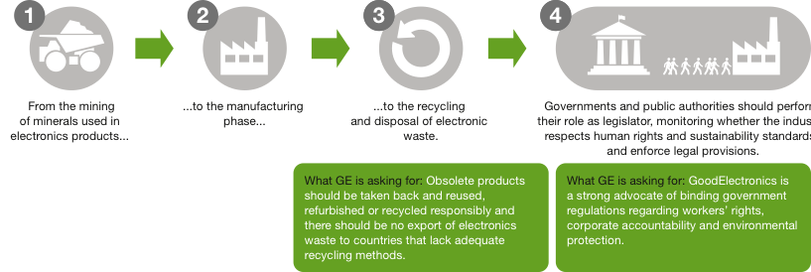
What would a good electronics industry look like?
CHAPTER 2
What would a good electronics industry look like?
GoodElectronics has a vision of a global electronics industry that follows the highest possible international human rights and sustainability standards. Following this vision, labour rights and environmental norms would be protected and respected throughout the entire electronics value chain:

Slide 9
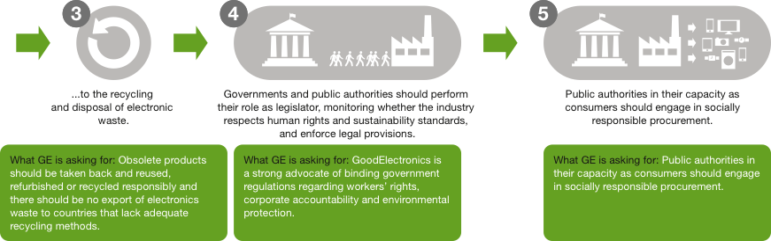
What would a good electronics industry look like?
CHAPTER 2
What would a good electronics industry look like?
GoodElectronics has a vision of a global electronics industry that follows the highest possible international human rights and sustainability standards. Following this vision, labour rights and environmental norms would be protected and respected throughout the entire electronics value chain:

Slide 10
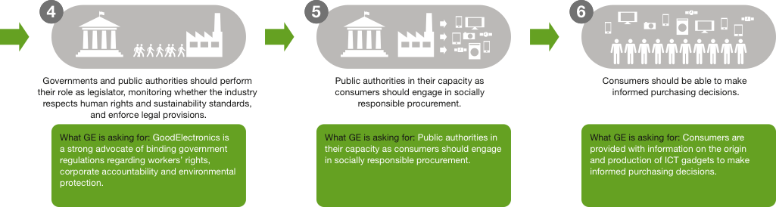
What would a good electronics industry look like?
CHAPTER 2
What would a good electronics industry look like?
GoodElectronics has a vision of a global electronics industry that follows the highest possible international human rights and sustainability standards. Following this vision, labour rights and environmental norms would be protected and respected throughout the entire electronics value chain:

Slide 11
What the GoodElectronics Network wants
CHAPTER 3
GoodElectronics has formulated a list of demands on the electronics sector that the network would like to see applied throughout the entire value chain, in each company’s own operations and in their supply chains.
This includes:
being fully transparent and accountable to the public;
adopting more sustainable manufacturing practices in order to protect the environment;
reducing and eliminating chemical and physical hazards by adopting safer alternatives;
eliminating all forms of precarious employment, like for instance the excessive use of short-term contracts;
ending gender exploitation and
ending the abuse of migrant labour.
See the website for a full list of positions and demands: GoodElectronics Common Demand on the Electronics Industry and Challenge to the Electronics Industry to Adopt Safer and More Sustainable Products and Practices, and Eliminate Hazardous Chemicals, Exposures and Discharges.
GoodElectronics programme draws heavily on the UN Guiding Principles on Business and Human Rights implementing the United Nations “Protect, Respect and Remedy” Framework and the OECD Guidelines for Multinational Enterprises to move beyond the social compliance approach towards new solutions for supply chain responsibility.

Slide 12
CHAPTER 3
What the GoodElectronics Network wants
Solutions lie in working towards due diligence, to avoid infringing on the rights of others and to address adverse impacts with which they are involved. There is an acute need for access by victims to effective remedy, both judicial and non-judicial.
In order to achieve this vision, GoodElectronics believes that civil society organisations have a crucial role to play in terms of
mobilising, informing and organising workers at a grassroots level;
monitoring and documenting corporate and governmental behaviour;
taking part in efforts to improve the electronics industry.
Strong, independent trade unions play a key role in social dialogue and collective bargaining, and in mature industrial relations between trade unions and employers. Training of workers concerning their rights and roles is of utmost importance.
With this in mind, in 2014, GoodElectronics launched a five-year programme, funded by the European Commission, that focuses on information, training and capacity building of workers and their representative organisations. GoodElectronics aims to empower civil society organisations – including trade unions – so that they can play their designated roles as a countervailing power, both at the local and the international level.

Slide 13
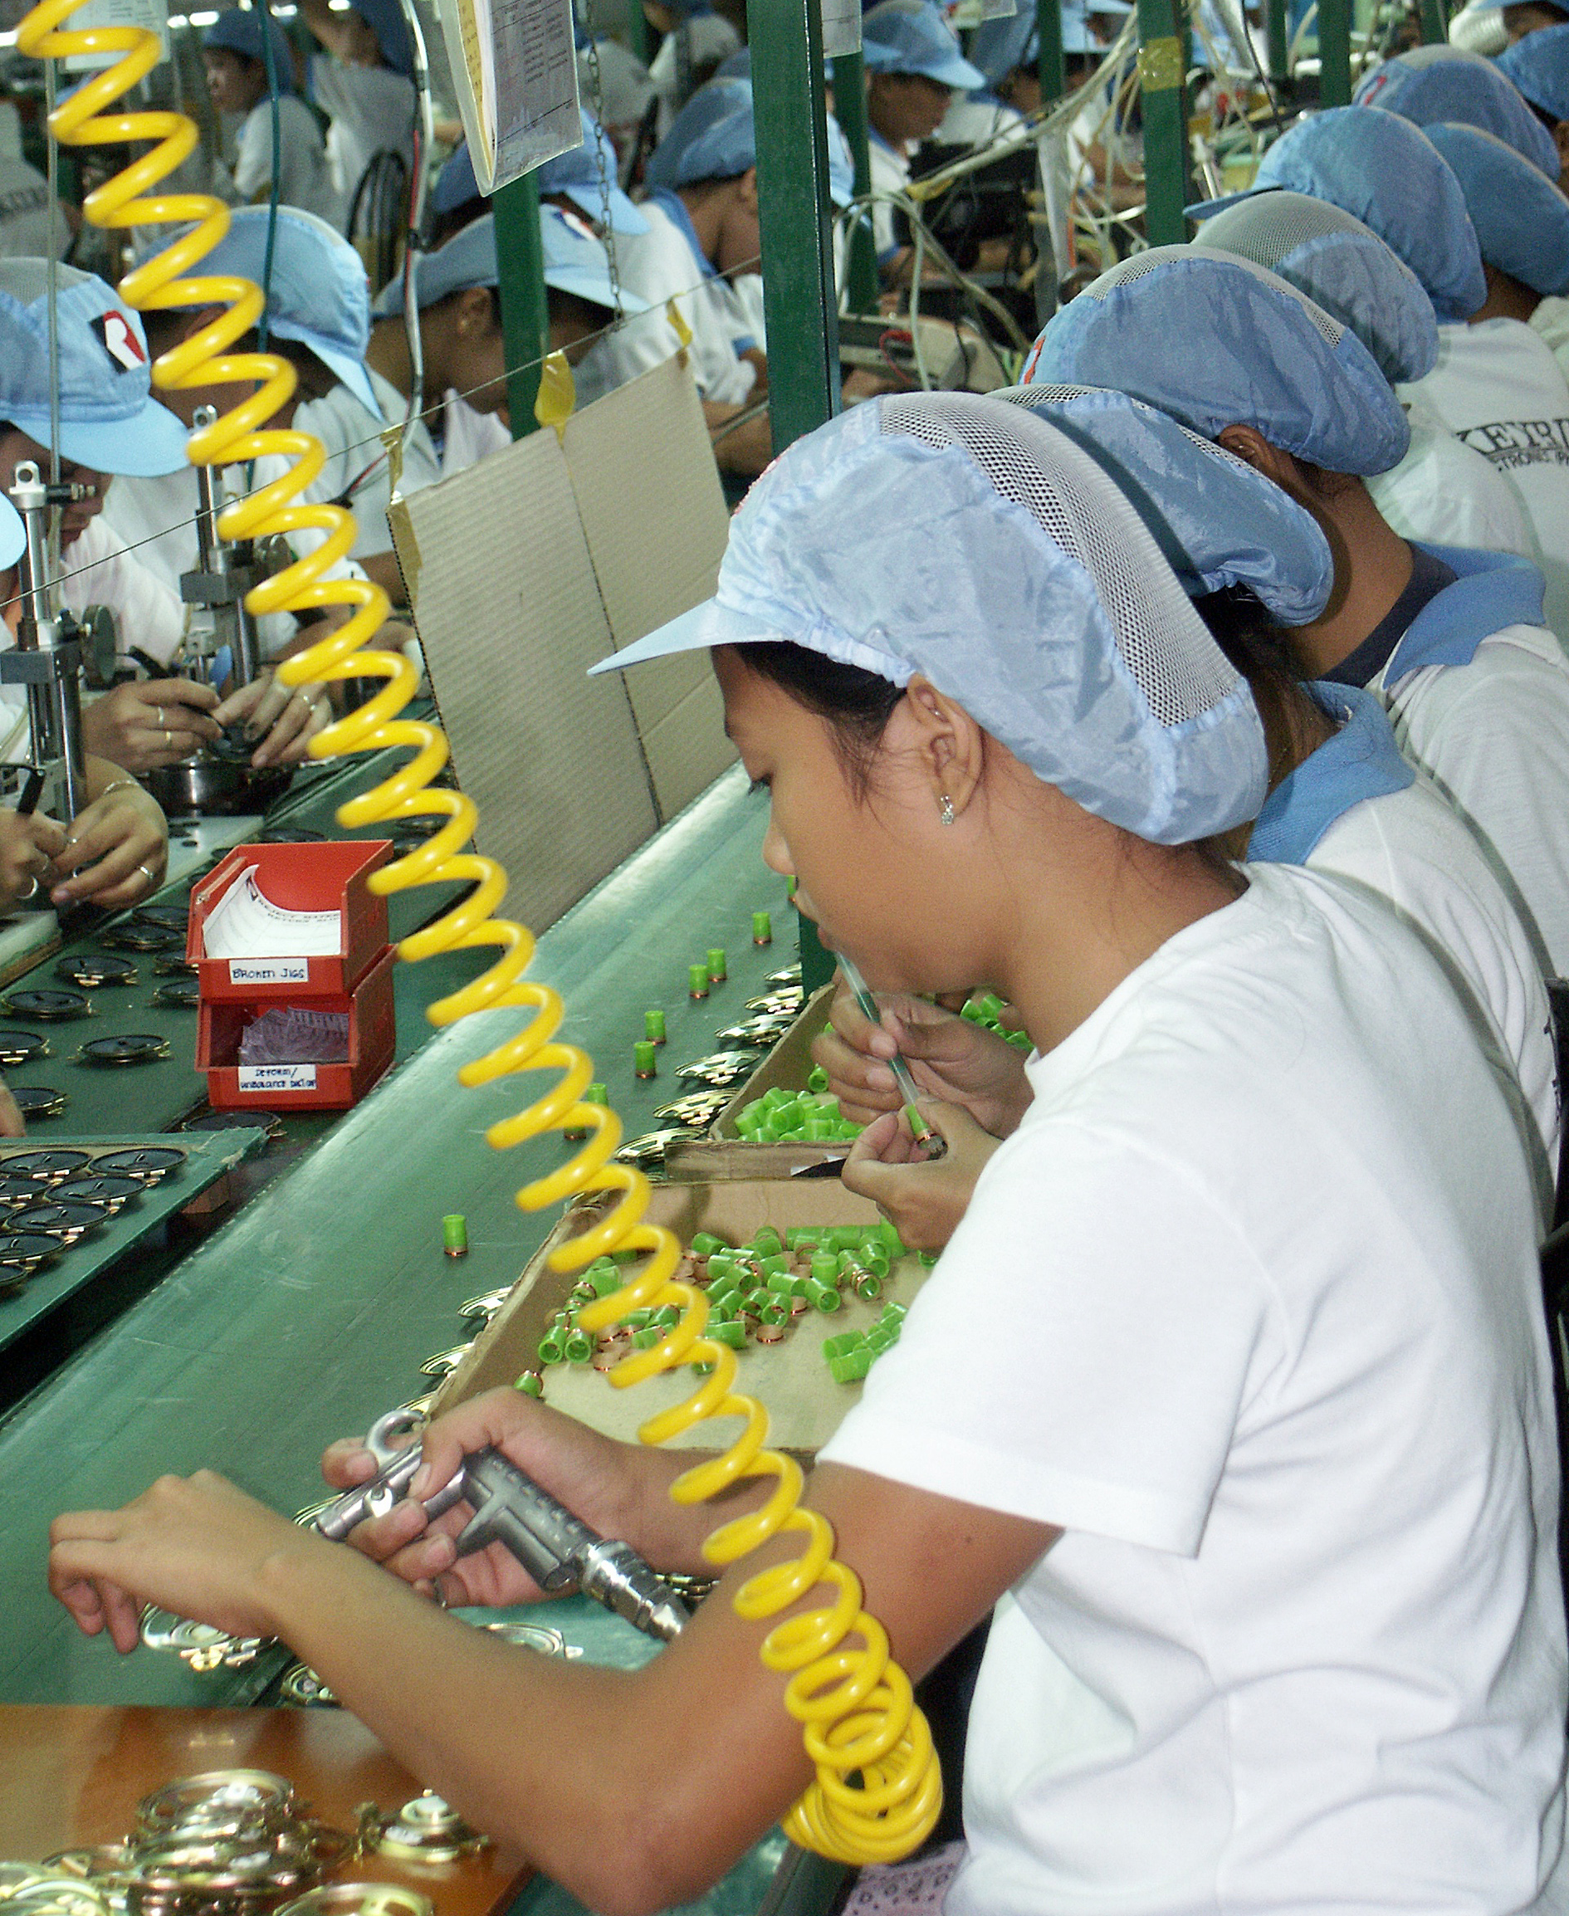
CHAPTER 3
What the GoodElectronics Network wants
The specific focus and activities of the programme include:
rolling out training to 10,000 workers in Asia and South America, with a special focus on women workers
developing meaningful engagement between civil society and electronics companies and other relevant actors along the global electronics supply chain
establishing mature industrial relations involving trade unions and electronics companies, on the national and global and the national level.
Co-funding is provided by the Dutch Ministry of Foreign Affairs, Swiss NGO Bread for All, Human Rights@Work Foundation, Sigrid Rausing Trust, CAFOD, FNV and membership contributions of IndustriALL Global Union.
Visit the website to find out more…
© Creative Commons SOMO / ITUC, International Trade Union Confederation / Natacha David

Slide 14


CHAPTER 3
What the GoodElectronics Network wants
An important part of the EC funded programme is being carried out by four steering group members of the GoodElectronics Network over the next five years:
Our host organisation SOMO, based in the Netherlands, is carrying out research to address corporate abuse and instances of precarious employment across the sector
Our Indian-based partner Cividep is training workers in India.

Slide 15


CHAPTER 3
What the GoodElectronics Network wants
Mexican-based labour organisation Centro de Reflexión y Acción Laboral – CEREAL – is training workers in Mexico.
IndustriALL Global Union – an umbrella organisation representing 50 million workers in 140 different countries – is responsible for training union activists and union leaders in five production countries in Asia: in Indonesia, Malaysia, Thailand, Taiwan and Vietnam.
Of course many other GoodElectronics members are also involved in carrying out the programme, in the form of smaller projects and activities, with funding that is provided through the sub-granting scheme and otherwise.

Slide 16

2014 in the spotlight
CHAPTER 4
GoodElectronics would like to share some of the programme’s 2014 highlights with you…
GoodElectronics has raised the issue of the right to freedom of association in all contacts with companies and industry bodies. In some cases with success: joint pressure by the network and IndustriALL, among others, led to a hard-fought collective bargaining agreement with semi-conductor supplier NXP in the Philippines. Read more… Check out this powerful and moving video depicting the dismissed NXP union activists.

Slide 17
CHAPTER 4
2014 in the spotlight
Our project partners between them helped to train more than 1,800 workers and 350 trade unionists about their rights as regards forming and joining unions, collective bargaining and occupational health and safety – 30% of people reached were women.
130 civil society organisations in 11 different countries received information about developments in the global electronics industry, including mining, manufacturing, e-waste disposal, market analysis and trends in corporate accountability.
Chemicals in general have risen high up the agenda of the Electronics Industry Citizenship Coalition (EICC), illustrated by the newly established “Chemicals Task Force”. Philips – one of the companies on the task force – has actively sought input from GoodElectronics and its partners when developing its supplier sustainability process chemicals approach.
Read more…
Our sub-granting team also approved seven applications from members of the network for a total of €28,000. Read more…

Slide 18
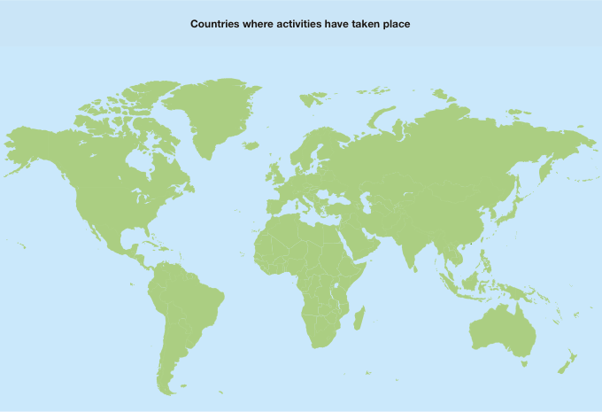
CHAPTER 4
2014 in the spotlight

Slide 19
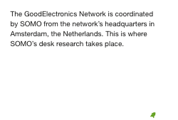
CHAPTER 4
2014 in the spotlight

Slide 20




CHAPTER 4
2014 in the spotlight

Slide 21

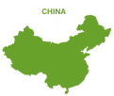

CHAPTER 4
2014 in the spotlight

Slide 22


CHAPTER 4
2014 in the spotlight

Slide 23
Getting the message out
CHAPTER 5
During 2014, as well as in 2015, the GoodElectronics Network focused on reaching out to more people and improving communications:

Slide 24

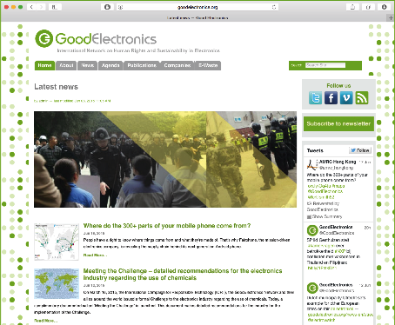
CHAPTER 5
Getting the message out
GoodElectronics new improved website had 26,212 unique visitors in 2014, an increase of 23.7% compared to 2013. Members can now join the network via the website here.

Slide 25
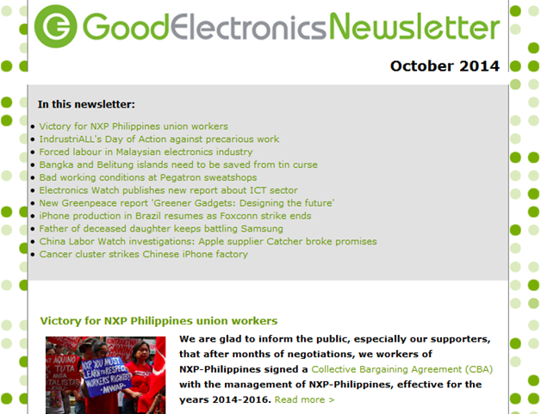

CHAPTER 5
Getting the message out
There are more than 1,300 subscribers to the GoodElectronics
E-newsletter, which was sent out 11 times during 2014 – keeping members informed and giving them the tools they need to play an informed and proactive role. Subscribe to the E-newsletter here.

Slide 26


CHAPTER 5
Getting the message out
The network also used social media to spread the word – doubling the number of followers on Facebook and increasing the number of followers on Twitter by more than 80%. Follow the GoodElectronics Network on Twitter and Facebook.

Slide 27

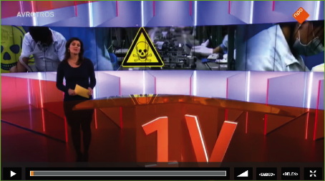
CHAPTER 5
Getting the message out
Throughout the year, the network received and responded to numerous media requests, leading to several items on Dutch national TV shows (‘Elektronica-industrie maakt vuile handen in china’, and ‘Giftige-stoffen-in chinese elektronicafabrieken’) and articles in respected publications including The Nation.

Slide 28
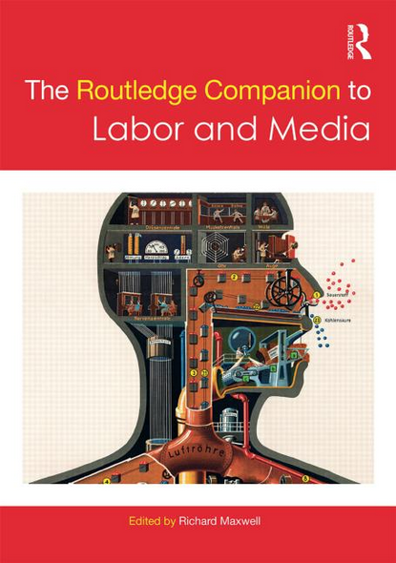

CHAPTER 5
Getting the message out
The GoodElectronics Network was invited to contribute a chapter to the Routledge Companion to Labor and Media, a collection of essays examining the work on the mostly unglamorous side of media and cultural production, technology manufacture and every occupation in between. The book is due to be published on 15 July 2015.
Read more.

Slide 29

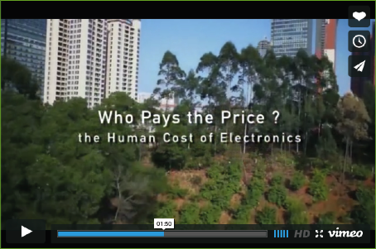
CHAPTER 5
Getting the message out
In 2014, filmmaker Heather White made a short video, ‘Who pays the price? The human cost of electronics’, featuring GoodElectronics coordinator Pauline Overeem. In the course of the year, White and her colleagues continued to work on a longer film. GoodElectronics has supported this project in several ways, with a modest financial contribution and by spreading the word about the project.

Slide 30
Highlighting problems in the industry – research & publications
CHAPTER 6
During the course of 2014, GoodElectronics Network host SOMO also started work on a series of research reports highlighting problems in different aspects of the electronics industry, in collaboration with other GoodElectronics members. Some reports were published in 2014; others are due to come out in 2015:

Slide 31

CHAPTER 6
Highlighting problems in the industry
Financial relationships between brands
and suppliers
GoodElectronics published an article by former Philips consultant Anthony Harris called Dragging out the best deal: How billion dollar margins are played out on the backs of electronics workers, which looks at the financial relationships between Electronics Manufacturing Services companies (EMS) – such as Flextronics, Foxconn and Jabil – and brand name companies of consumer electronics including Apple, HP, Lenovo, Dell, Acer, Asus
and LG.

Slide 32

CHAPTER 6
Highlighting problems in the industry
Company profile ASM International
In April 2014, GoodElectronics published the first of some 20 company profiles, focusing on the Dutch company ASM International N.V. (ASMI). This report was triggered because a young employee of ASM Pacific Technology (ASMPT) in China fell ill with leukaemia, after reportedly being exposed to the carcinogenic substance benzene on the work floor. The main argument was that ASMI should take responsibility for addressing health risks at the factories of its former subsidiary company, ASMPT. The report’s publication was marked by an expert meeting jointly organised by the network and FNV Mondiaal, which was covered by Dutch and international media. On the basis of the report, questions were raised at the ASMI shareholders’ meeting in 2014.

Slide 33
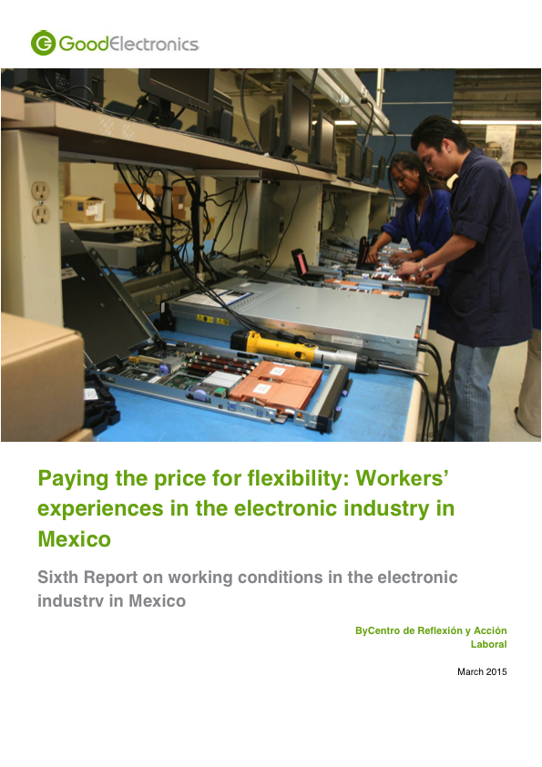
CHAPTER 6
Highlighting problems in the industry
Research on labour conditions in the Mexican electronics industry
Mexican labour group and project partner CEREAL undertook research into the labour conditions in the electronics industry in Mexico. The findings on restriction of freedom of association, lack of collective negotiations, wages below the official poverty line were highlighted in a report published on 31 March 2015. Companies that are portrayed in the report include IBM, Jabil, Foxconn, Sanmina SCI and Microsoft. Read the report…

Slide 34
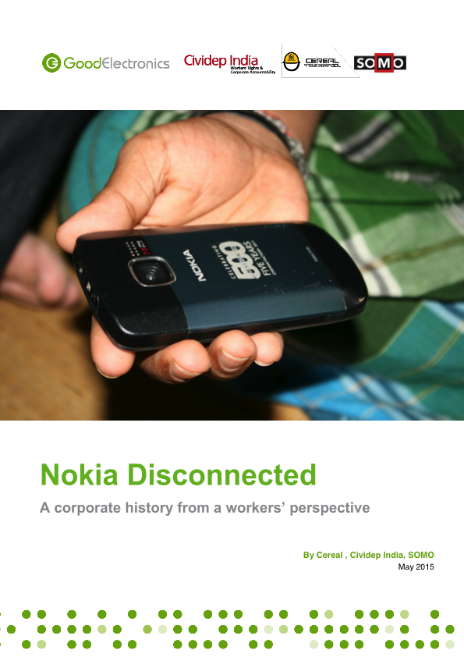
CHAPTER 6
Highlighting problems in the industry
Company Profile Nokia/Microsoft
Project partners SOMO, CEREAL and Cividep worked on a publication looking into and analysing Nokia’s corporate strategy of relocating production from developed to developing countries such as India and Mexico, as well the takeover of Nokia by Microsoft. CEREAL is covering the experience of workers in Mexico, while Cividep is bringing in the Indian side of the story. SOMO is co-author and has brought in expertise with regard to analysing the business strategy. The report was published on
4 May 2015 in time for the Nokia shareholders’ meeting in Helsinki. Read the report…

Slide 35
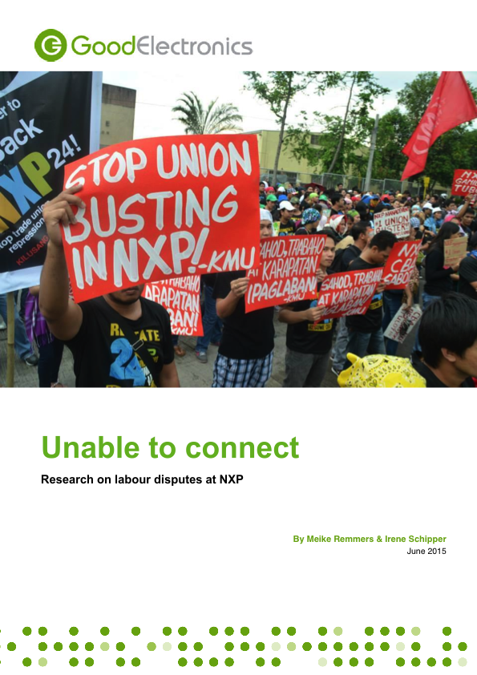
CHAPTER 6
Highlighting problems in the industry
Company Profile NXP
In 2014, SOMO also started preparation for a profile on the Dutch company NXP Semiconductors N.V. that looks into union busting and harassment of union leaders in the Philippines and Thailand. This profile was published on 2 June 2015. Read the report…

Slide 36
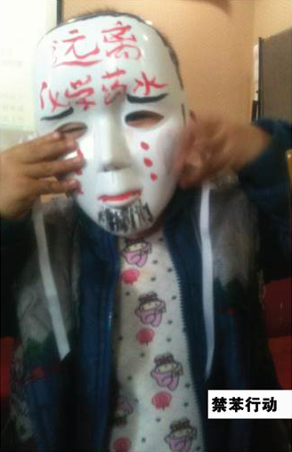
CHAPTER 6
Highlighting problems in the industry
Research on chemical poisoning in China
SOMO also started preparatory work with GoodElectronics member Labour Action China (LAC) and Labour Education Service Network (LESN) that will result in an analytical publication on chemical poisoning in the electronics industry in China, focusing on the obstacles workers have to surmount in getting recognition, work-related diagnosis, medical support and compensation. LAC and LESN have been gathering case studies that will form the basis for holding companies accountable, in order to get compensation for the victims.
©Labour Action China

Slide 37


CHAPTER 6
Highlighting problems in the industry
Katanga calling – cobalt in electronics
After smelting and refining, minerals such as cobalt are used in consumer products like mobile phones and laptops, car batteries, tools, lenses, jewellery and healthcare. Ethical sourcing of minerals has been central to the debate about supply chain responsibility, with some specific steps taken on conflict minerals. However, much more is needed in order to improve the human rights and environmental conditions in mining areas. Based on preparatory work done in 2014, GoodElectronics, Friends of the Earth and SOMO published a brochure documenting the human and environmental costs of cobalt extraction in Katanga in the Democratic Republic of Congo (DRC) in May 2015. Read the brochure…

Slide 38
CHAPTER 6
Highlighting problems in the industry
Chemical Challenge
More and more evidence is popping up about the bad effects of chemicals on workers in the production process. Based on preparatory work done in 2014, GoodElectronics and the International Campaign for Responsible Technology (ICRT) organised a meeting in January 2015 bringing together workers, labour unions, industrial hygiene and occupational health and safety experts to discuss issues and joint strategies.
The Challenge to the industry was published in March 2015. An additional document with detailed recommendations to the industry was published in June 2015. With these tools, GoodElectronics and ICRT will continue to inform workers and their representative organisations of their rights with regard to OHS, and call upon the industry to take their responsibility. Read Challenge…

Slide 39
Informing and training workers by GoodElectronics programme partners
CHAPTER 7
As well as activities with a global orientation, GoodElectronics’ programme partners have been busy informing and training workers and unionists in India (Cividep), Mexico (CEREAL) and in five Asian countries (IndustriALL). Here are some highlights:

Slide 40
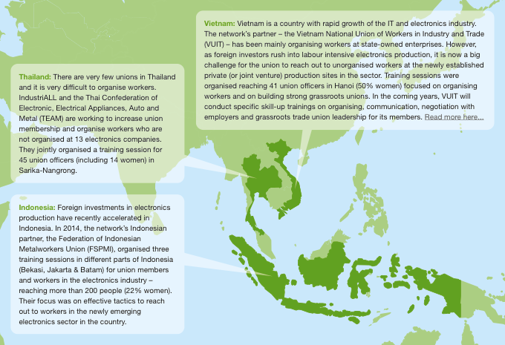
CHAPTER 7
Informing and training workers

Slide 41
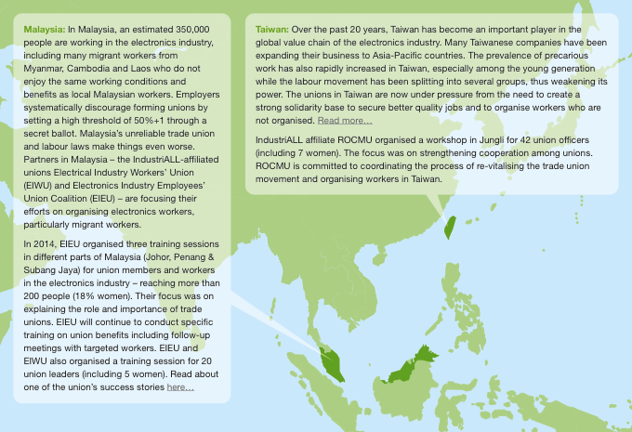
CHAPTER 7
Informing and training workers

Slide 42
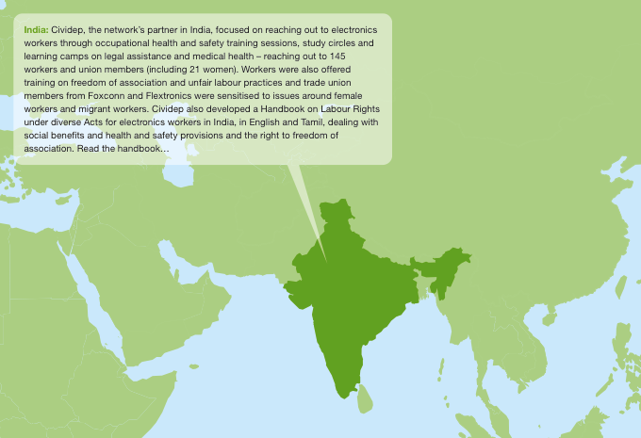
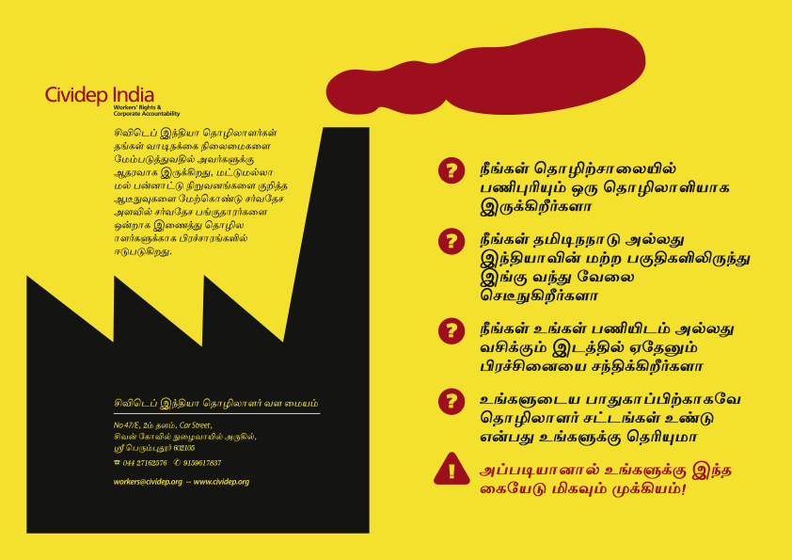
CHAPTER 7
Informing and training workers

Slide 43
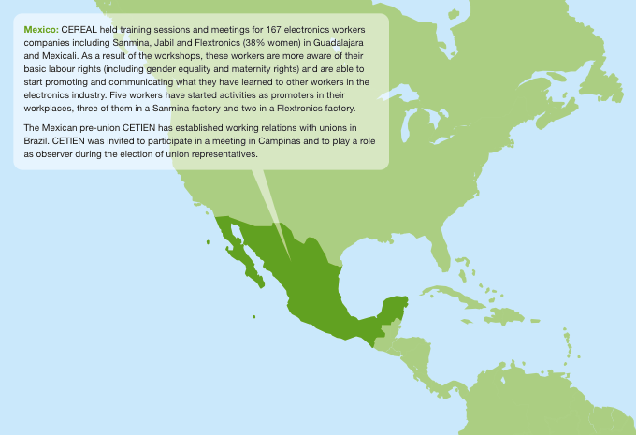
CHAPTER 7
Informing and training workers

Slide 44
Engagement with the electronics industry
CHAPTER 8
Negotiations with Sanmina SCI in Mexico
In Mexico, CEREAL has engaged directly with electronics companies to improve conditions for workers, including negotiating an agreement with Sanmina SCI on crucial labour issues.
Participation in Fairphone’s Worker Fund
SOMO participated in the Fairphone ‘Made with Care Working Group’, leading to a Worker Fund that is managed by democratically elected workers at the plant where the Fairphone is assembled in China.
Issues with NXP in Thailand
In 2014, GoodElectronics Thailand (GET) has been working on the issue of freedom of association, engaging directly with NXP Manufacturing Thailand. Read more…
Campaigning against retrenching Nokia workers in India
During 2014, GoodElectronics was highly concerned about the spree of retrenching electronics workers in the Sriperumbudur industrial area in Tamil Nadu, India. The trend was set when Nokia India started to lay off workers in April 2014. This had a cascading effect on Nokia’s supplier companies such as Foxconn and Build Your Dreams (BYD). The jobs of thousands of workers were at stake. Together with partners, the network called on Nokia to reconsider the relocation to Vietnam and to stop using voluntary retirement schemes as a tool to lay-off workers. Read more…

Slide 45
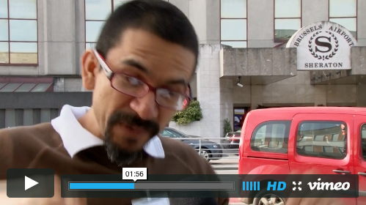
CHAPTER 8
Engagement with the electronics industry
Demands on EICC
GoodElectronics presented 5 demands on the Electronic Industry Citizenship Coalition by means of a video. EICC is a potentially important industry body of electronics brands and manufacturers, that is, however, failing to effectively address major human rights issues in the global electronics industry. Over the past years, GoodElectronics has repeatedly called on EICC to address ongoing problems including low wages, long workhours, no trade unions, and the lack of proper grievance mechanisms.
The video, with contributions by GoodElectronics members CAFOD, IndustriALL, CEREAL, people & Planet and SOMO, was made at the occasion of the EICC Code of Conduct review process. See video here…

Slide 46
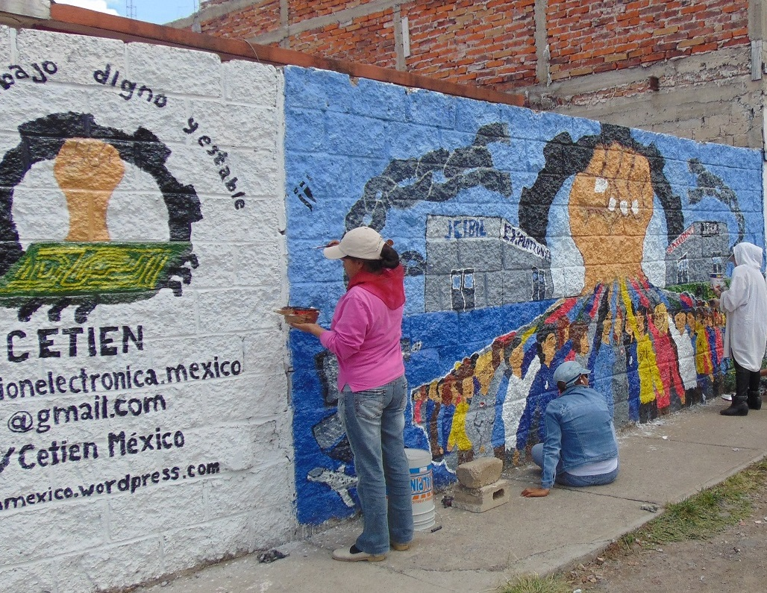
Campaigning activities: some examples
CHAPTER 9
Campaign for living wages
IndustriALL-affiliated unions are campaigning for an increase in minimum wages to secure a living wage, the reform of the social security system and for limiting outsourcing in favour of decent jobs.
Read more…
Mural for moral support for workers
CEREAL’s support has strengthened pre-union CETIEN – a coalition of workers and ex-workers in the electronics industry. CETIEN facilitated the creation of a mural depicting labour rights and labour conditions in Hacienda de Santa Fe, one of the most densely populated neighbourhoods on the outskirts of the city, where many electronic and other workers live.
© Cereal

Slide 47
CHAPTER 9
Campaigning activities: some examples
Campaign on tin mining
Throughout 2014, GoodElectronics supported the Friends of the Earth Netherlands (Milieudefensie) campaign highlighting the negative environmental and social effects of tin mining in Indonesia. The electronics industry is an important consumer of tin. As a result of the campaign, major brands like Apple, Dell, Microsoft and Asus have started to disclose information about the origin of the tin they are sourcing and have committed to sustainable tin mining in Indonesia. Read more…
Expert meeting on chemicals
Efforts in China have been focused on the harmful chemicals used in the electronics industry. In April 2014, GoodElectronics, FNV Mondiaal and Labour Action China (LAC) organised an expert meeting in Amsterdam on the issue of chemical poisoning in China. Participants included Dutch trade union representatives, NGOs and other experts with a professional interest in manufacturing in China.
The discussion focused on benzene, a highly carcinogenic chemical that is used in different industrial processes in electronics, toys, shoe and furniture manufacturing. Recently 13 workers in an iPhone factory in China were diagnosed with leukaemia; five of these workers (all aged between 19 and 24 years old) have subsequently died.

Slide 48
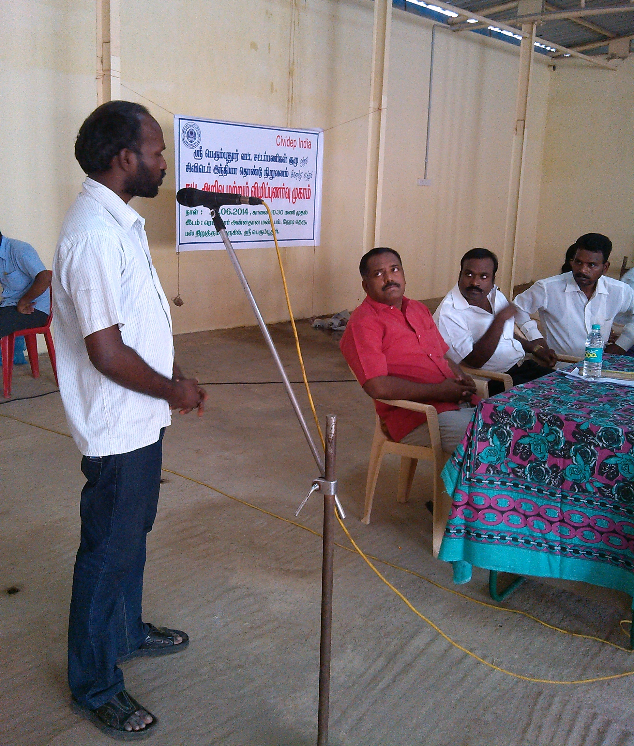
Supply chain transparency
CHAPTER 10
Supply chain transparency is crucial so that workers, NGOs and consumers know whom to address when labour issues arise:
GoodElectronics is calling on electronics companies to provide information about their corporate structure, including their subsidiaries.
It is calling on brands, agents/retailers and local manufacturers to share information about first and further tier suppliers, including factory names, possible alternative factory names, locations, whether they are strategic suppliers, the duration of the supplier relationship, etc.
It is also calling on business initiatives, multi-stakeholder initiatives and trade associations to take the lead in facilitating further supply chain transparency in the electronics sector.
© Cividep

Slide 49
CHAPTER 10
Supply chain transparency
The GoodElectronics Network believes that big brands should develop a pro-active view on sharing business-related information, within the limits of anti-trust regulations. Companies should communicate openly about audit procedures, specific audit findings, specific corrective action plans and certification schemes.
Reporting on corporate social responsibility (CSR) should cover the due diligence procedures of each company. And, crucially, communication on CSR should provide enough information to assess the adequacy of the steps taken by the enterprise.
GoodElectronics is also calling on governments to make basic information available on imports and exports as well as on public procurement, including brands, volumes, values, etc. for different product groups.
Protection of labour rights and environmental protection are unfortunately distant points on the horizon.
Electronics companies are still not taking enough responsibility for labour rights violations, nor are they taking enough action to prevent and address human and labour rights abuses along their supply chains.
With over 15 million employees working in the electronics sector around the world and the electronics industry continuing to expand at a significant rate, GoodElectronics will keep on calling upon the industry to respect human rights and the environment. The focus will very much be on China as a major production hub; the lion share of the world’s electronics component makers and electronics assembly factories are located in China. Union rights and collective bargaining in China are, however, at an embryonic stage.

Slide 50
Looking ahead
CHAPTER 11
The emphasis in 2014 has been on core labour issues in the manufacturing phase, but GoodElectronics will maintain a focus on the entire supply chain. Going forward the network is diversifying its focus towards occupational health and safety, as well as e-waste and urban mining.
Publications
A number of research publications are planned for the next five years. The idea is to dive deeper and in a more analytical way into selected themes including:
Student labour;
Occupational health and safety;
Electronics contract manufacturers;
Electronics waste;
Financialisation of profit making;
Labour rights issues related to business strategies;
How big brands monitor & audit freedom of association;
Child labour in mining;
Effectiveness of multi-stakeholder initiatives in the electronics sector;
Country profile of the electronics industry in Brazil.
Updating GoodElectronics membership base and evaluating communication
In 2015, GoodElectronics will carry out an update of the membership base and a thorough evaluation of the internal and external communication tools and make sure that the network is reaching out to as many people as possible as effectively as it can.

Slide 51
Stay in touch
If you like to find out more about how the GoodElectronics Network continues to fight to make sure that people are put before profits across the electronics industry, please visit the GoodElectronics website.
Sign up to the GoodElectronics Network newsletter to keep up to date with all the latest news here.
If you have any questions, please don’t hesitate to contact the GoodElectronics Network at info@goodelectronics.org, FaceBook or Twitter.
Thank you!

